Slide 1
Main findings of EDF Human Rights Report on legal capacity
Marine Uldry – EDF Human Rights Policy Coordinator
14 December 2024

Slide 2


Slide 3
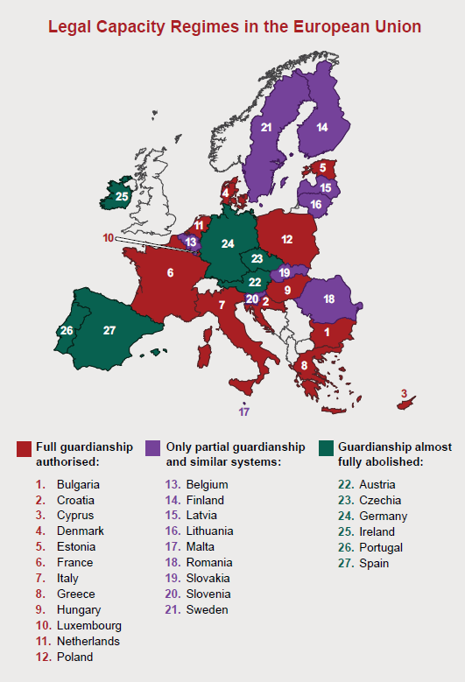
Legal capacity regimes in the European Union

Slide 4
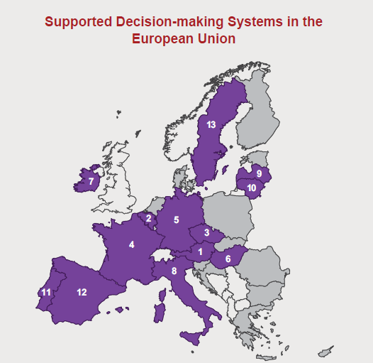
Supported decision-making systems in the European Union

Slide 5
Thank you!
Special thanks to all of you
Notes:
Final slide Thank you!
Special thanks to:
Follow us on social media @MyEDF

